Slide 1
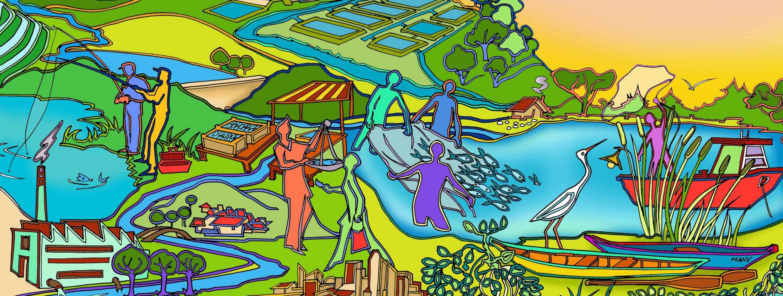
Session 4 Principles of EAFm
Essential EAFm training
Date |Place

Slide 2
Session objectives
After this session you will be able to:
Examine the principles of EAFm and their link to the FAO Code of Conduct for Responsible Fisheries (CCRF)
Notes:
Self explanatory. Ask who knows about the FAO Code of Conduct for Responsible Fisheries and/or regional derivatives

Slide 3
Group Timelines
Horizontal line represent ‘time’
Go back in time 30 – 40 years (e.g. 1980). Think of events that have affected or been affected by your fisheries (political, environmental, social, etc.) Events can be from local to national to global
Draw/write each event (with dates) on a separate card
Plot your cards onto the timeline
Notes:
See full details in Session Plan. Trainer puts up Flipchart sheets on wall, explains that line represents time + writes a few key dates and ‘now’ next to the line. Explain that group will collectively develop a timeline of their country’s fishery. They need to think of events that have affected their fishery (e.g. obvious increases or reductions in resources/ laws/ changes in practices/fuel price ups or downs/ natural disasters/ changes in government/ set up of conservation areas... anything that has affected their fishery). Elicit an example, write it down as 1 sentence on card/ post it and stick it on timeline to show participants what to do. The discussion here is just as important as final product, as it brings out institutional memory. Trainer needs to ensure that events related to people, policy and environment (many external drivers) are expressed (we do not want cards with only fishery events).

Slide 4
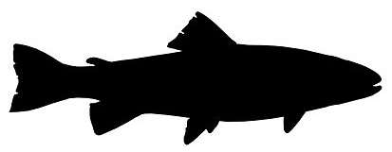
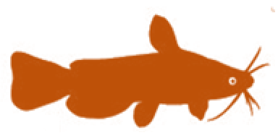
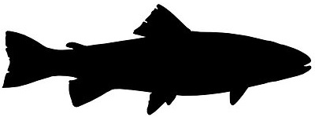
Key Principles of EAFm
1. Good governance
2. Appropriate scale
3. Increased participation
4. Multiple objectives
5. Cooperation & coordination
6. Adaptive management
7. Precautionary approach
Notes:
There are 7 principles. At this stage of the course simply read these out (Note P1 = Principle 1). These are expanded on later.
P1: Good governance
P2: Appropriate scale
P3: Increased participation
P4: Multiple objectives
P5: Cooperation and coordination
P6: Adaptive management
P7: Precautionary approach
See Participant Handbook Module 4, Figure 4.1

Slide 5
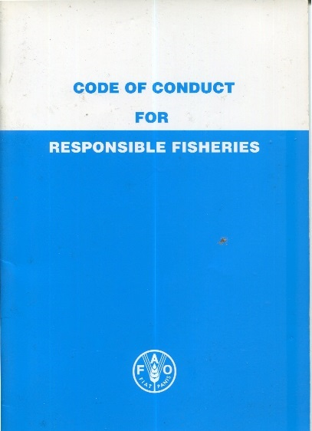
Principles are not new
The principles of EAFm are not new but were set out in the FAO Code of Conduct for Responsible Fisheries (CCRF)
The CCRF was developed by Food and Agriculture Organization of the United Nations (FAO)
All FAO Member countries agreed to CCRF in 1995
Your country is a Member of FAO
Notes:
Stress that the principles of EAFm are not new but grew out of the acceptance of the concept of sustainable development. For the sustainable development of fisheries, the FAO developed a Code of Responsible Fisheries, which was agreed to by all FAO member countries in 1995. All countries attending this course are members of FAO.

Slide 6
Good governance
Consensus
GOOD GOVERNANCE
Accountable
Participatory
Follows the rule of law
Transparent
Effective
and efficient
Equitable and inclusive
Responsive
Notes:
The First Principle of EAFm is Good governance. Good governance includes: effective institutions and arrangements for setting and implementing rules and regulations. This slide shows 8 characteristics of good governance. Discuss each of these; ensure participants agree with meaning.
See Participant Handbook Module 4 for details and figure 4.2 for details on each of these 8 characteristics.
(Accountability = both upwards and downwards)
Diagram from http://www.unescap.org/pdd/prs/ProjectActivities/Ongoing/gg/governance.asp

Slide 7
Appropriate scale
Four dimensions:
Ecological scales
Socio-economic scales
Political/governance scales
Temporal scales
Note: These align with the three components of EAFm
Notes:
These align with the 3 components of EAFm (introduced in morning session 2). The 3 main scaling dimensions are (i) Ecological scaling – trying to align with ecosystem boundaries, (ii) Socio-economic scaling – trying to include the appropriate socio-economic issues and (iii) political/governance scaling – who has the mandate to manage. Also scaling needs to consider changes over time i.e. temporal.
See Participant Handbook Module 4 for details.

Slide 8
Scales – extremes
Single species ➔ multiple species
Small areas ➔ large areas (e.g. basin, watershed or transboundary water body)
Ecological
Socio-economic
Village ➔ Floodplain/Lake/Basin (rural & urban)
Governance
Single jurisdiction ➔ Multiple jurisdictions
Temporal
Short-term ➔ Long-term
Notes:
To try and clarify what we mean by scaling, we can consider two extremes along each of the 4 dimensions i.e. (i) from single species to large marine ecosystems, (ii) from a village up to a whole coastline, (iii) from a single jurisdiction to multiple jurisdictions and (iv) from short-term to long-term considerations.

Slide 9
Realities of scale
Take a practical approach
Begin working with what exists e.g. jurisdictional boundaries (district, province), or a particular water body or river
Challenge:
Getting the scale correct for the four dimensions
(Ecological, socio economic, political/governance & temporal)
This often requires increased cooperation and coordination across jurisdictions, agencies and stakeholders.
Notes:
The ideal scale is based on an ecosystem scale.
However, in reality the scale at which fishery management occurs will be primarily determined by existing jurisdictional and political boundaries, but there are some general socio-economic and ecological issues, which, if considered would help broaden the mandate of fisheries management.
It is best to work with practical scales and boundaries- this means that the stock or fishery under consideration should also be framed within meaningful jurisdictional boundaries. (e.g. water body, river, reservoirs, or governmental jurisdiction such as province or district/state level).

Slide 10
Discuss
In many countries, fisheries management has been devolved down to the district/municipality level.
In your groups, answer the question:
“Is the district/municipality the correct scale to manage all fisheries?”
Notes:
What scale do you work at? How would you scale? This discussion should take into account:
different fish ranging from shallow water resources to small pelagic species in open waters,
highly migratory fish versus floodplain blackfish
different fishing gears harvesting the same resource e.g. small-scale fishers and gears close to shore, larger motorized gears, or large trap systems. There is not much use managing the small scale community fishing if most of the problems are caused by larger scale gear units (and vice versa)!!!

Slide 11
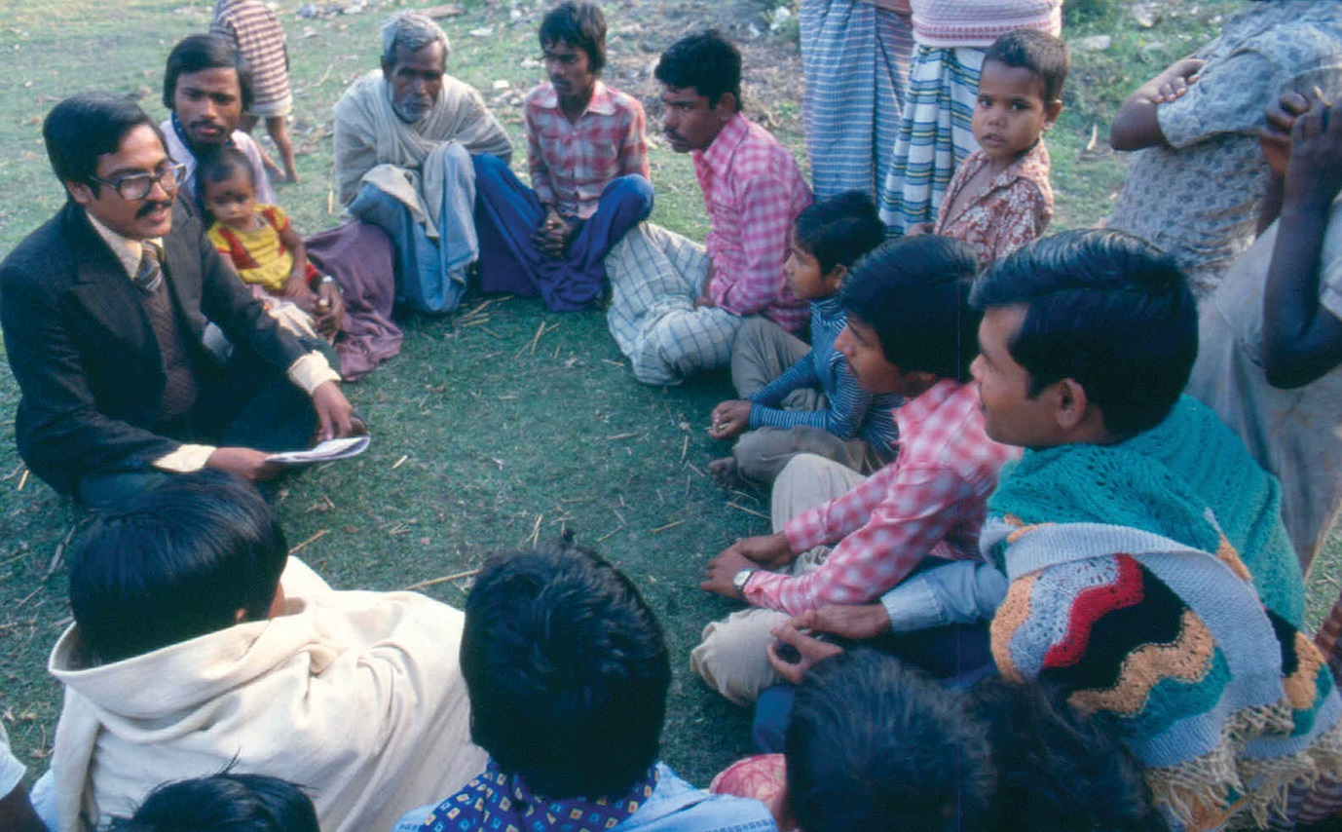
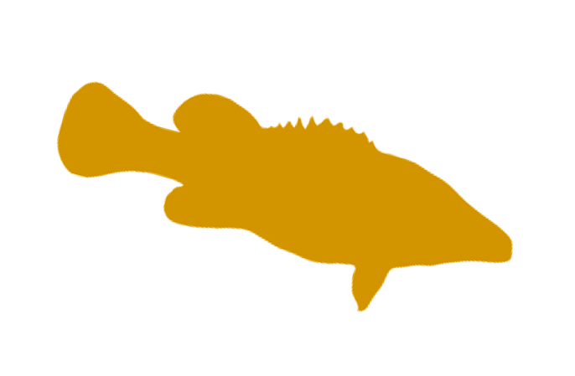
Increased participation
Participation is central to the process
Notes:
Much more on the importance of participation later in the course. See Participant Handbook Module 4 for more details.
Get participants to say why this is actually NOT ideal photo of participation (no women stakeholders; clothing of speaker (suit and tie) suggests hierarchy….this will vary culturally)
To foster participation facilitator needs to try to ‘blend’ in more; also paper notes (power) are not shared (they are held by the speaker).
Photo source: FAO.

Slide 12
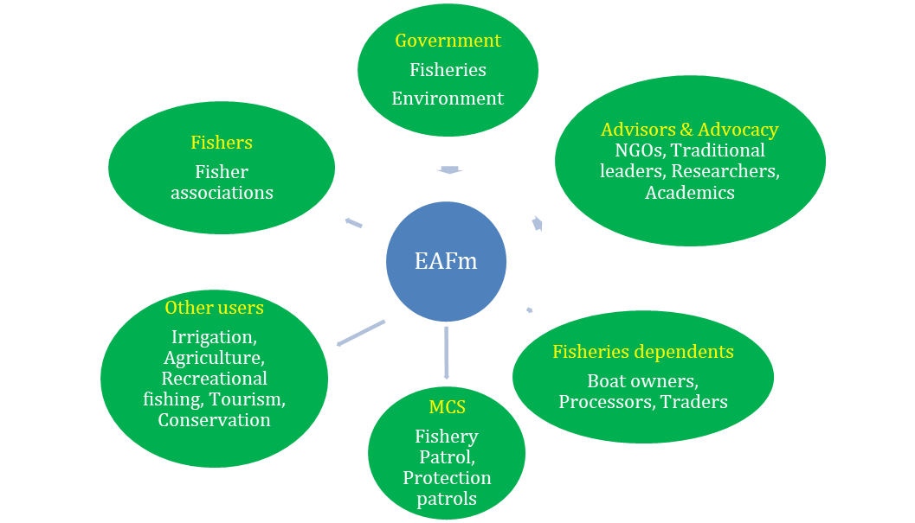
Many stakeholders
Fishers and fisher associations
Governments (district – national)
Fishery related (e.g. boat owners, fish traders, money lenders)
Compliance and enforcement agencies (e.g. inspector)
Other users (e.g. tourism, irrigation, hydropower)
External agents (e.g. NGOs, researchers)
Notes:
EAFm involves a diversity of stakeholders- here are some example categories. We will discuss in more detail in Start up A and B.
(The visual of diversity of EAFm stakeholders is from Session/Module 8 (slide 9).

Slide 13
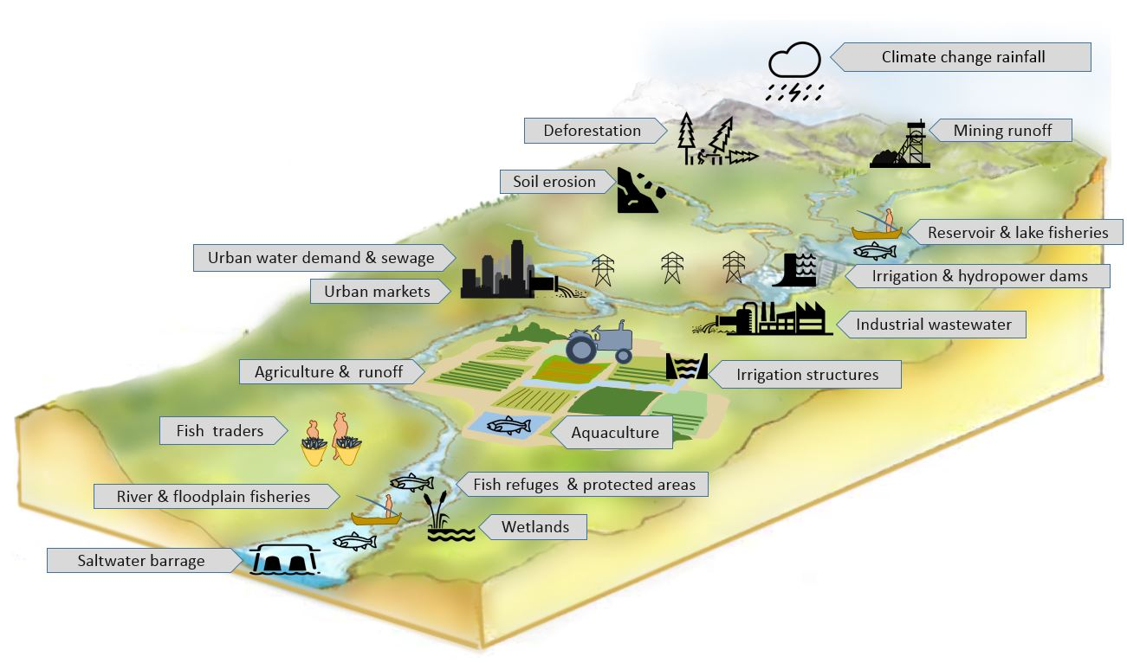
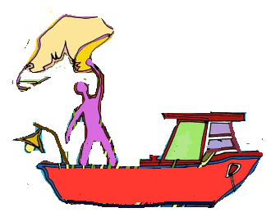
Multiple objectives
EAFm deals with interactions within the fishery sector and with other users
Each sector and user group usually have their own objectives
Need to balance these objectives
Requires stakeholder engagement and negotiation
Notes:
Because EAFm involves finding the balance between ecological well-being and human well-being, there will be many objectives coming from the different stakeholders (jargon for this is societal objectives). In many cases, these objectives will conflict and, as an important principle of EAFm we need to address these multiple objectives and find TRADE OFFS (as we started discussing in session before lunch).
See Participant Handbook Module 4 for more details.

Slide 14
Cooperation and coordination
EAFm involves cooperation and coordination among many stakeholders e.g.
within agency/institutions
across institutions, both government and stakeholder and with non-fishery sectors
from global to national to district levels
Fishers
Fisher associations
External agents
Water managers
Traders
NGOs Researchers
Government
National/regional/ provincial/state/ municipal/ village
Notes:
For EAFm it is necessary to coordinate and cooperate (i) horizontally: within and across institutions/agencies, both government and stakeholder, and also with non-fishery sectors, and (ii) vertically from national to district levels.
See Participant Handbook Module 4 for more details.

Slide 15
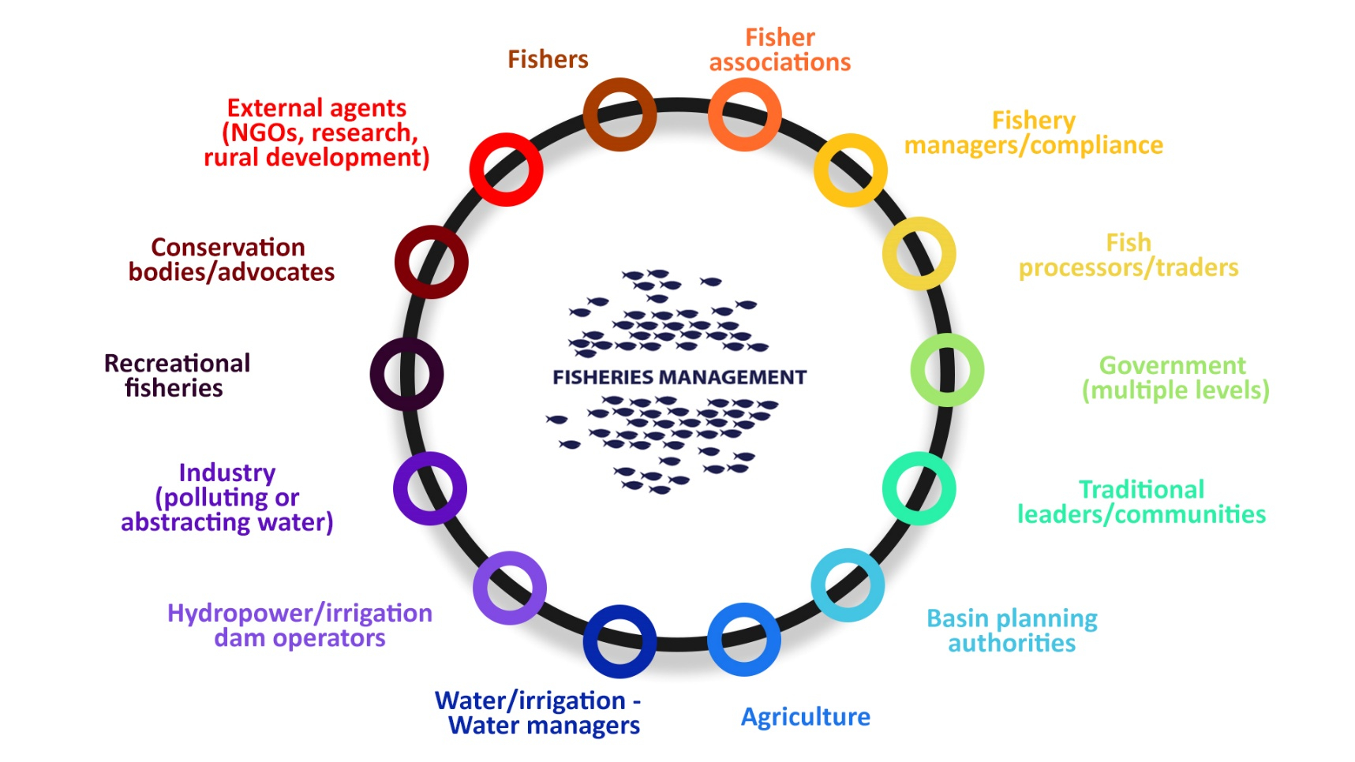
The institutions
Notes:
Remember we need to include the government and other stakeholders. Because there are so many stakeholder groups, we will need to select representatives of the many institutions e.g. fishers need to be organize into fisheries association. Not all stakeholders need to be involved all the time.
This is a visual of the main actors and required linkages. Going clockwise from the bottom, point out stakeholders that affect or are affected by the fishery. These are (i) riparian communities and water users (ii) fishers, (iii) governments at various levels, including water management and environment, and lastly (iv), what is called here “external agents”. Other agencies could include Research Institutes, Enforcement Officers, etc.
See Participant Handbook Module 4, Figure 4.4.

Slide 16
Institutional cooperation and coordination
How do you achieve this?
Talk to others
Link in with existing arrangements (e.g. IWRM, water user associations, etc.)
Share information
Develop a plan through a participatory process
Harmonize work plans/budgets
Memorandums of understanding/binding agreements
...... Any other suggestions?
Notes:
Briefly discuss - we will come back to this on day 4, Step 4 (session 15) for implementation.
Use this slide 16 to outline some practical ways in which increased cooperation and coordination could be achieved. Elicit examples from participants.

Slide 17
Adaptive management
Learning while doing
Evaluate
Improve
Discard
Work
Evaluate
Improve
Discard
Work
Evaluate
Improve
Discard
Uncertainty
Certainty
TIME
Notes:
In adaptive management you start management actions as soon as practical and despite uncertainty and learn from what you have done by evaluating the outcome. Over time, the lessons learnt will reduce the uncertainty.
Adaptive management provides a framework for managing for change over time by learning from doing.
One big advantage of adaptive management is that it can be used in data-poor situations.
One example is reducing fishing effort. All the existing evidence highlights the need for a reduction of fishing effort. However, we do not know what the optimum fishing effort level really is. In this case, you start reducing and monitor the result until, several years later the optimal effort is more obvious.
This links closely to the precautionary principle (next slide). In the example, you do not have to know what the optimum level is to start managing.
See Participant Handbook Module 4, Figure 4.5.

Slide 18
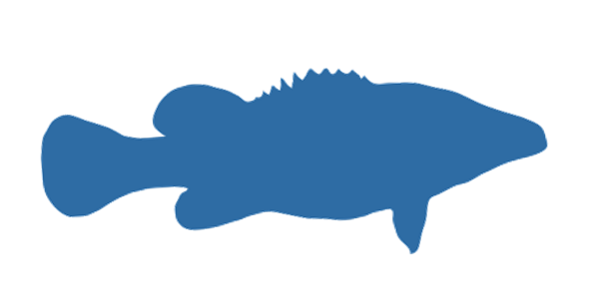
The precautionary approach
“… States shall be more cautious when information is uncertain, unreliable or inadequate. The absence of adequate scientific information shall not be used as a reason for postponing or failing to take conservation and management measures” (UN, 1995)
Where there is uncertainty, management actions should be less risky
Lack of information should not be used as reason to delay action
Notes:
From UN Fish stocks agreement. Links closely with the principle of adaptive management. Simply put (i) you do not wait until you have all your scientific data before you make decisions/ act/ manage, and (ii) it also means that where there is uncertainty, any actions need to be less risky.
An example: Country xxx knows that there are untapped fishery resources in shared waters. However, the extent of the resource is not known. Rather than doing more research cruises, the fishery is opened to only a limited number of boats (2-3) which, in exchange for the right to fish, must provide data on catch, effort and costs. From this data, the extent of the resource will become more certain and the number of boats can be adjusted accordingly.
See next slide for another example.
See Participant Handbook Module 4 for more details.

Slide 19
THE PRECAUTIONARY APPROACH
Source: Adapted from ICSF (2013)
19
Notes:
Here is another example. In this example it is known that when fishers fish in an area with certain gear (e.g. small mesh trawls), they catch small fish and also the catch of fish for other gears is less. However, there is no evidence of this. Faced with this uncertainty, it was decided to introduce bigger mesh sizes until the fishers could prove that their small-meshed nets were not causing any harm.

Slide 20
Key messages
EAFm principles are not new
based on the FAO Code of Conduct for Fisheries (to which your country is a member)
EAFm has seven principles
These are all important for implementing EAFm
Notes:
Self explanatory

